Slide 1

Revision
Intellectual property
Method of protection

Slide 2

Data Privacy
Data privacy, also called information privacy, is the aspect of information technology that deals with the ability an organization or individual to determine what data in a computer system can be shared with third parties.

Slide 3
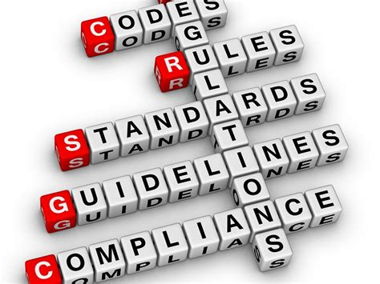
Data Privacy Rules/Laws
The data protection Act this sets out regulation for storing and access to personal data
The Personal data shall be:
processed lawfully, fairly and in a transparent manner in relation to individuals
collected for specified, explicit and legitimate purposes
adequate, relevant and limited to what is necessary
Accurate and, where necessary, kept up to date.
Should not be kept longer then it needed.
Processed in a manner that ensures appropriate security of the personal data,

Slide 4
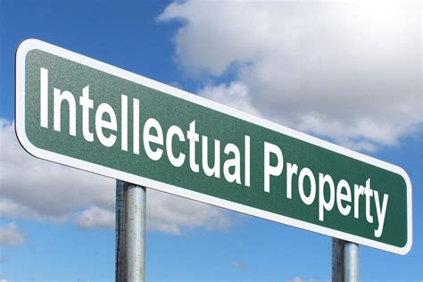
Intellectual Property
Intellectual property (IP) refers to unique and original works such as ideas, inventions, art, writings, processes, company and product names, and logos. (creation of the mind)

Slide 5
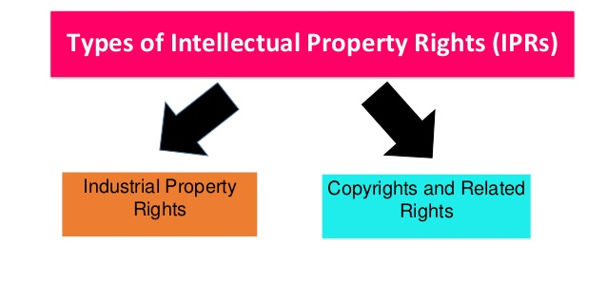
Physical matter that is the product of and idea or concept for commercial purposes
Types
A form of intellectual property law that protects original works or authorship such as music, movies, computer software ect.

Slide 6
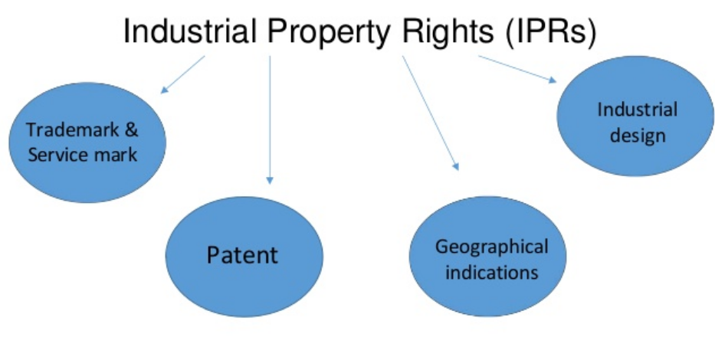
Industrial Property Rights

Slide 7
Patent
Patents protect the owner's invention from being made, sold, or used by anyone else for a certain amount of time. Patents give inventors the right to sell their product or to make a profit from it by transferring that right to another person or business.
Trademarks help to protect the names, marks, and slogans of products and companies. Trademarks make it easy for customers to distinguish competitors from one another, help to avoid any confusion, and deter misleading advertising. Trademarks are automatically assumed. As soon as a business starts using a mark or brand name, you can follow up that symbol with TM without having to file it with the government.
Trademarks

Slide 8
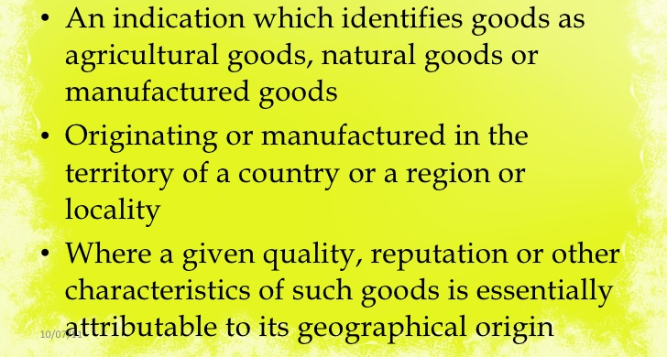
Geographical Indication (GI)

Slide 9
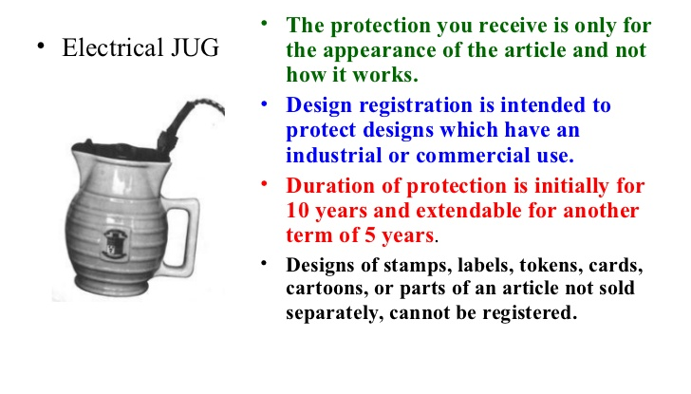
Industrial Designs

Slide 10
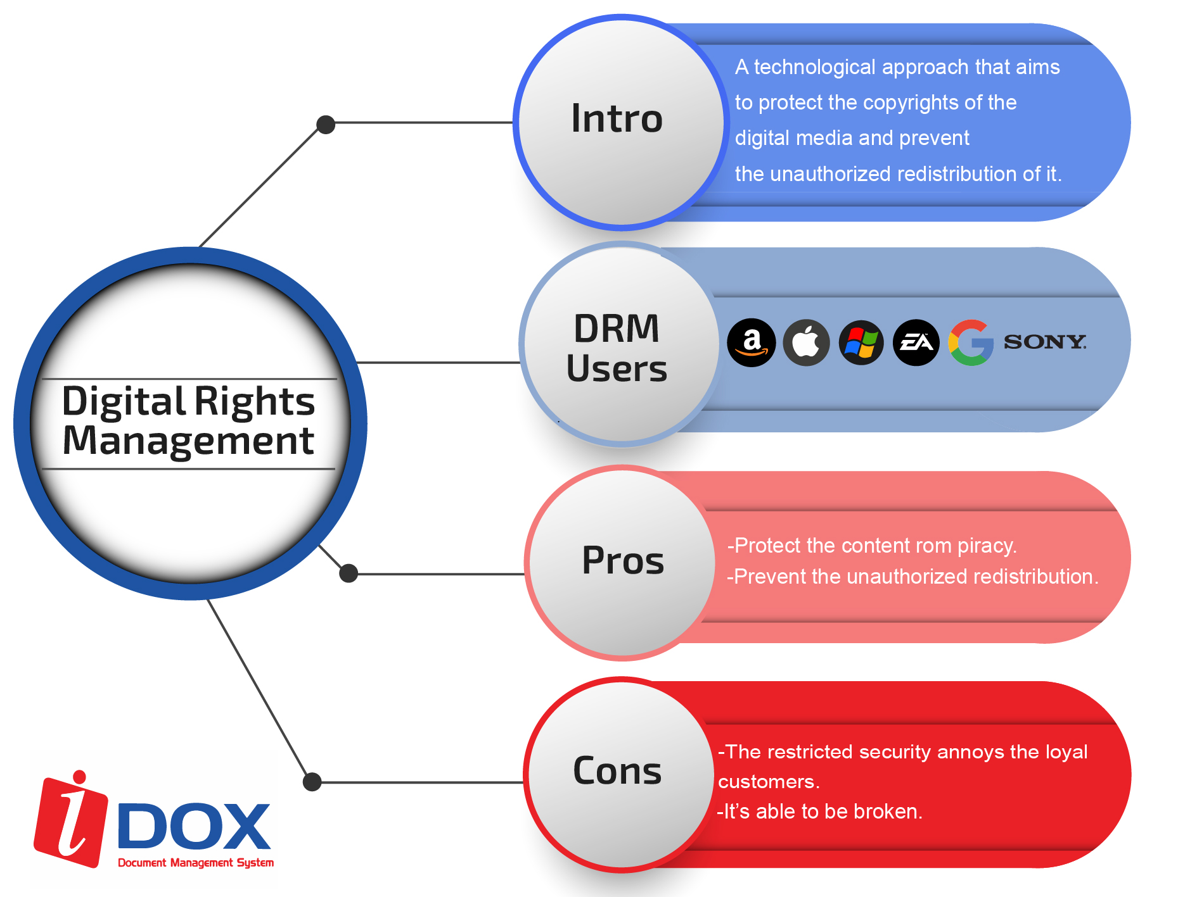
Digital Rights Management (DRM)

Slide 11

Licensing
An intellectual property license will authorize you as the intellectual property holder (licensor), to allow another parties (licensees) the right to use your creation for a certain fee.
A user need permission/license to exercise exclusive rights of the copyright owner unless the law provides otherwise
Pression should be obtained

Slide 12


Types of License

Slide 13

Creative Common
Creative Commons (CC) is a framework that allows the user rights to use and access a wide range of content.
It lets creators communicate the terms through which they want their work to be used.
If a work is under the creative common license, it does not mean it is free to use for any purpose.
When using CC images, it’s important you comply with the specific terms of each license, to avoid infringing copyright and any legal issues that may ensue.

Slide 14
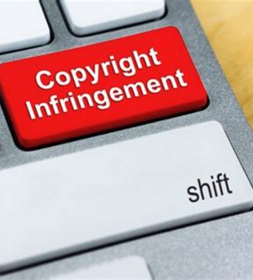
Copyright Infringement
Breaking the law
is against the law.
The copyright holder has the right to sue
Breaking the law is unethical
Do your part
Show responsibility
Know the facts
Ask for permission

